Slide 1


Slide 2
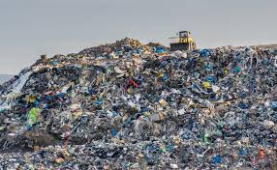
PALESTINE
850,000 ton of waste per year.
Recycled → 1.7%
HUGE Pollution
Losing millions$

Slide 3
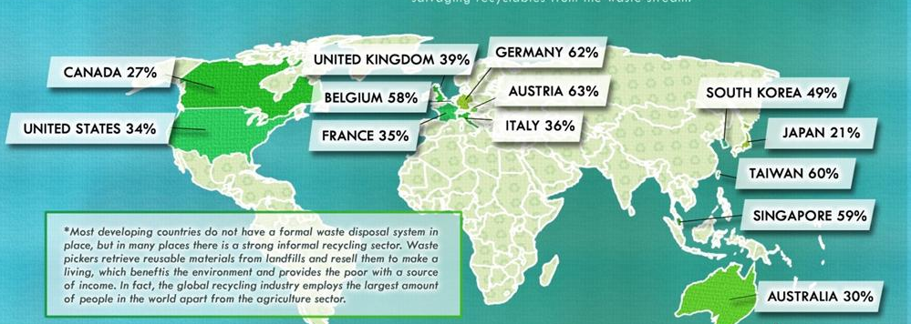
Around the world → 2.1 Billion tons of waste per year.
Recycled percentage →
Recycling Rates round the world.
  Unrecycled waste → burnt, buried, or landfills which increases air pollution.

Slide 4
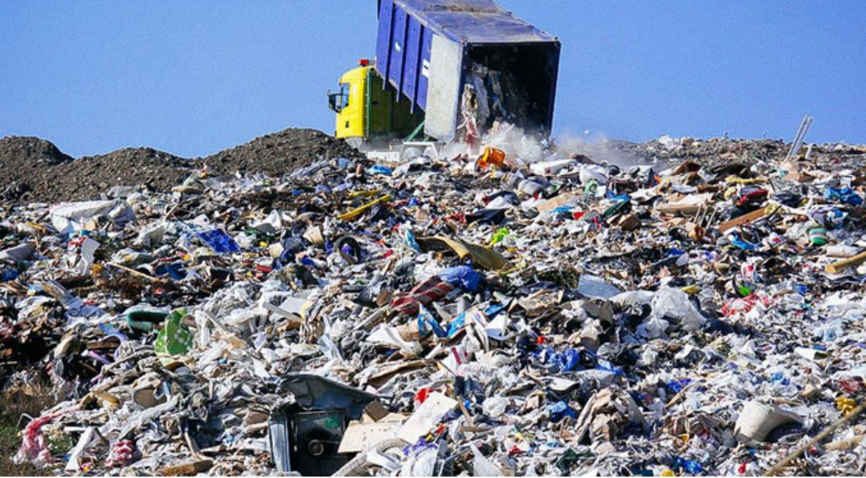
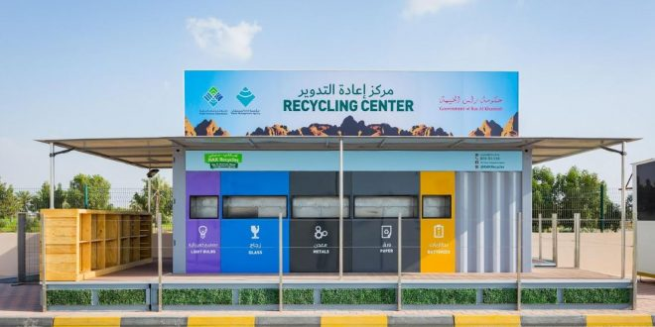
This is due to many PROPLEMS!
Time and effort.
Reaching recycling centers easily.
Exploiting Green and Creative Ideas well.

Slide 5
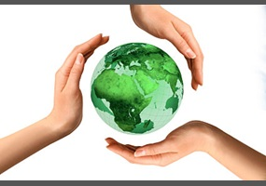
GIVE A BREATH

Slide 6
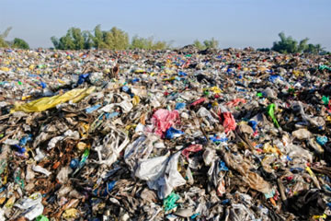
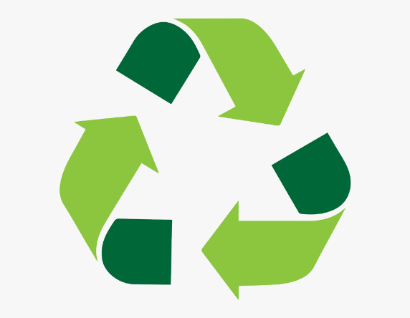
Eco-Bridge
Application
To bridge the gap between people and recycling centers.
Environment Citizens Recycling Centers
Sell waste
Share eco- Ideas
Market eco-project
Learn how to build a project

Slide 7
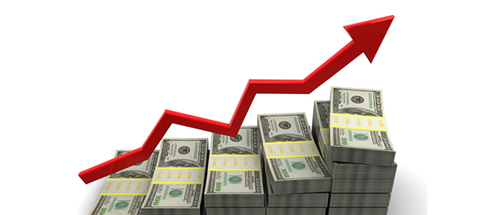
How?
Larger amounts of productivity.
Highest profits
2. More costumers.

Slide 8
How to sell waste?
Material?
Recycling Center?
Which agent?
Make your purse and environment happy

Slide 9
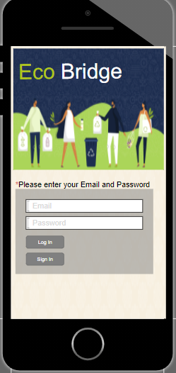
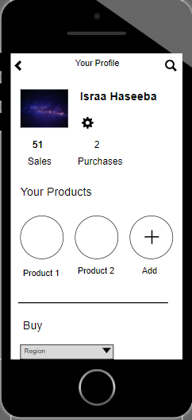
Prototype

Slide 10
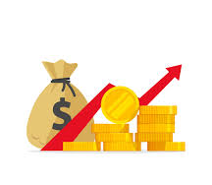
Profits per year
Online earnings.
Companies subscription fees.
A nominal percentage of sold products through the App.
At a beginning total = 500,000 $
By 2029
Millions of dollars + MILLIONS FRIENDS of the Environment

Slide 11
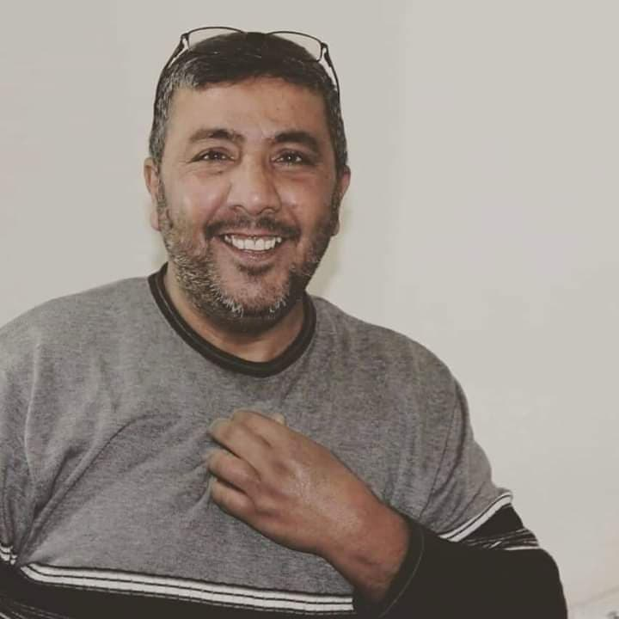
We got our First Costumer!!
Abu Sharar Company
for Plastic Recycling
In Hebron

Slide 12
Arab World:
Economic losses→ exceeds 5 Billion $/Year.

Slide 13
Eco-Bridge

